Slide 1
Dr. Ayan Mukherjee
Department of Physics, Ram Ratan Singh College, Mokama, Patna
Patliputra University, Patna
e-Content for B.Sc Student (Physics Hons)
Atomic Physics
1 Atomic Structure and the Periodic Table
2 Total Angular Momentum
3 Zeeman Effect

Slide 2
Atomic Structure and the Periodic Table
What would happen if there are more than one electron?
a nucleus with charge +2e attracting two electrons.
the two electrons repelling one another.
Can not solve problems exactly with the Schrödinger equation because of the complex potential interactions.
Can understand experimental results without computing the wave functions of many-electron atoms by applying the boundary conditions and selection rules.

Slide 3
Pauli Exclusion Principle
To understand atomic spectroscopic data for optical frequencies, Pauli proposed an exclusion principle:
No two electrons in an atom may have the same set of quantum numbers (n, ℓ, m_{ℓ}, m_{s}).
It applies to all particles of half-integer spin, which are called fermions, and particles in the nucleus are fermions.
The periodic table can be understood by two rules:
The electrons in an atom tend to occupy the lowest energy levels available to them.
Pauli exclusion principle.

Slide 4
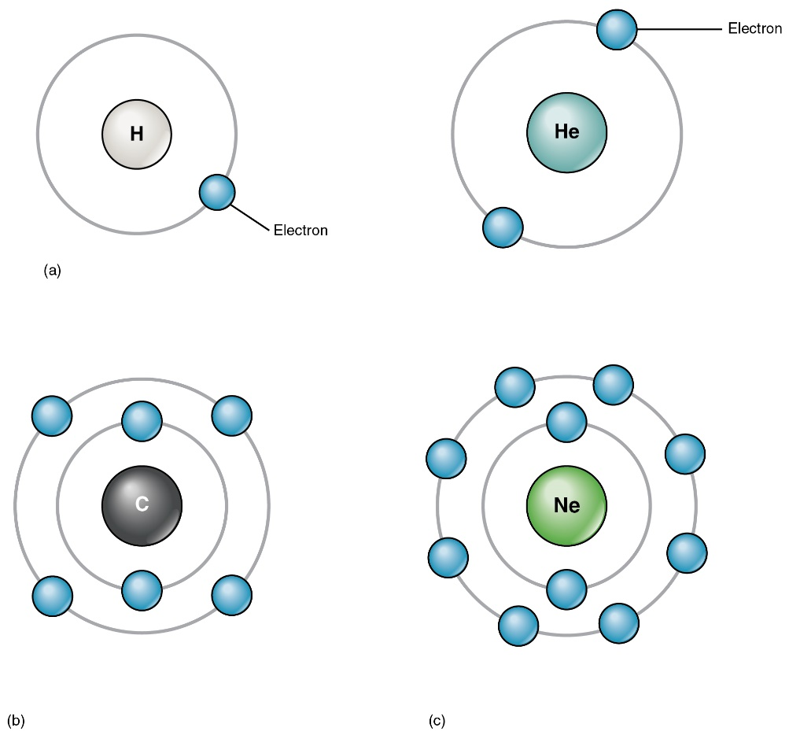
Atomic Structure
Electrons for H and He atoms are in the K shell.
H: 1s²
He: 1s¹ or 1s

Slide 5
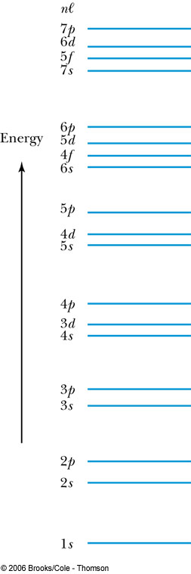
Atomic Structure
How many electrons may be in each subshell?
Recall: ℓ = 0 1 2 3 4 5 …
letter = s p d f g h …
ℓ = 0, (s state) can have two electrons.
ℓ = 1, (p state) can have six electrons, and so on.
 | Total
For each m_{ℓ}: two values of m_{s} | 2
For each ℓ: (2ℓ + 1) values of m_{ℓ} | 2(2ℓ + 1)
The lower ℓ values have more elliptical orbits than the higher ℓ values.
Electrons with higher ℓ values are more shielded from the nuclear charge.
Electrons lie higher in energy than those with lower ℓ values.
4s fills before 3d.

Slide 6
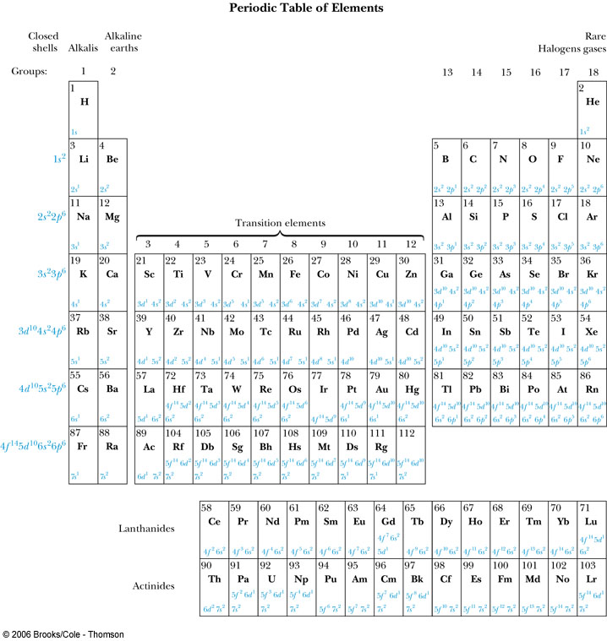
The Periodic Table

Slide 7
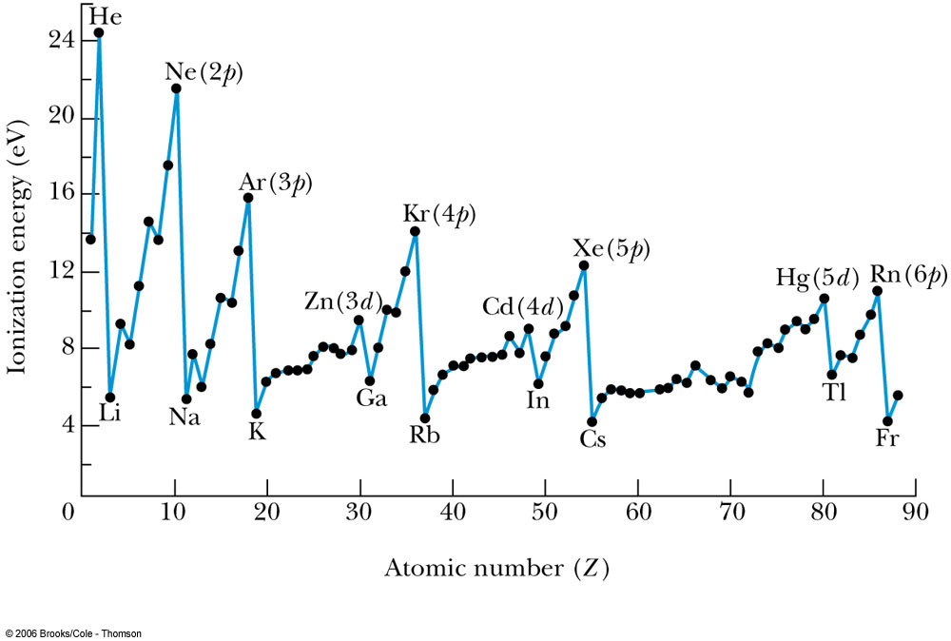
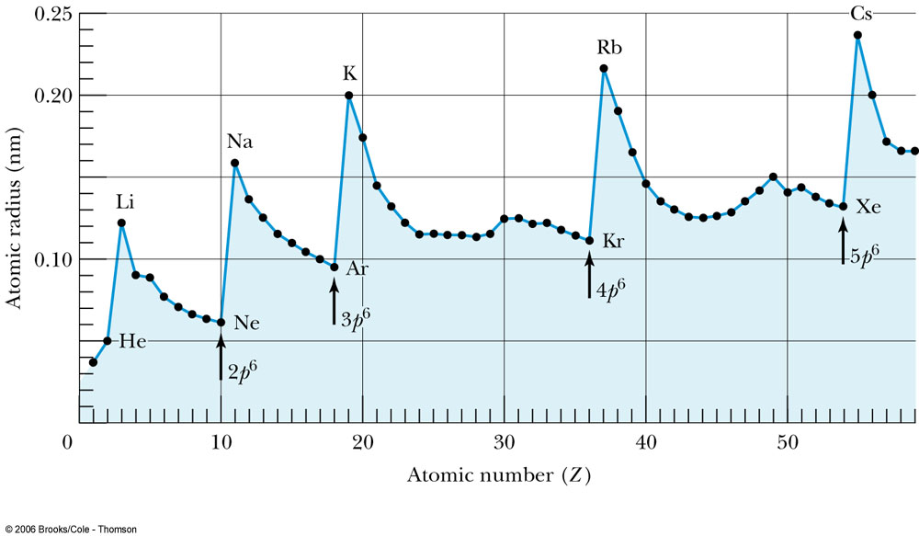
Groups and Periods
Groups:
Vertical columns.
Same number of electrons in an ℓ orbit.
Can form similar chemical bonds.
Periods:
Horizontal rows.
Correspond to filling of the subshells.
Some properties of elements are compared by the ionization energies of elements and atomic radii.

Slide 8
The Periodic Table
Inert Gases:
Last group of the periodic table
Closed p subshell except helium
Zero net spin and large ionization energy
Their atoms interact weakly with each other
Alkalis:
Single s electron outside an inner core
Easily form positive ions with a charge +1e
Lowest ionization energies
Electrical conductivity is relatively good
Alkaline Earths:
Two s electrons in outer subshell
Largest atomic radii
High electrical conductivity

Slide 9
The Periodic Table
Halogens:
Need one more electron to fill outermost subshell
Form strong ionic bonds with the alkalis
More stable configurations occur as the p subshell is filled
Transition Metals:
Three rows of elements in which the 3d, 4d, and 5d are being filled
Properties primarily determined by the s electrons, rather than by the d subshell being filled
Have d-shell electrons with unpaired spins
As the d subshell is filled, the magnetic moments, and the tendency for neighboring atoms to align spins are reduced

Slide 10
The Periodic Table
Lanthanides (rare earths):
Have the outside 6s² subshell completed
As occurs in the 3d subshell, the electrons in the 4f subshell have unpaired electrons that align themselves
The large orbital angular momentum contributes to the large ferromagnetic effects
Actinides:
Inner subshells are being filled while the 7s² subshell is complete
Difficult to obtain chemical data because they are all radioactive
Have longer half-lives

Slide 11




Total Angular Momentum
Orbital angular momentum
Spin angular momentum
Total angular momentum
L, L_{z}, S, S_{z}J and J_{z} are quantized.

Slide 12
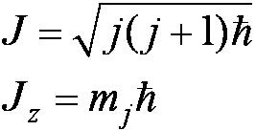
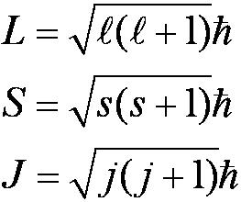

Total Angular Momentum
If j and m_{j} are quantum numbers for the single electron (hydrogen atom).
Quantization of the magnitudes.
The total angular momentum quantum number for the single electron can only have the values

Slide 13






Spin-Orbit Coupling
An effect of the spins of the electron and the orbital angular momentum interaction is called spin-orbit coupling.
is the magnetic field due to the proton.
where cos α is the angle between .
The dipole potential energy .
The spin magnetic moment ∝ .
.

Slide 14
Total Angular Momentum
No external magnetic field:
Only J_{z} can be known because the uncertainty principle forbids J_{x} or J_{y} from being known at the same time as J_{z}.

Slide 15


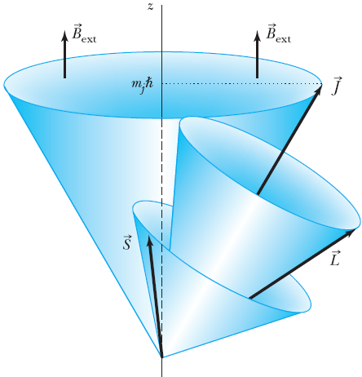
Total Angular Momentum
With an internal magnetic field:
will precess about .

Slide 16
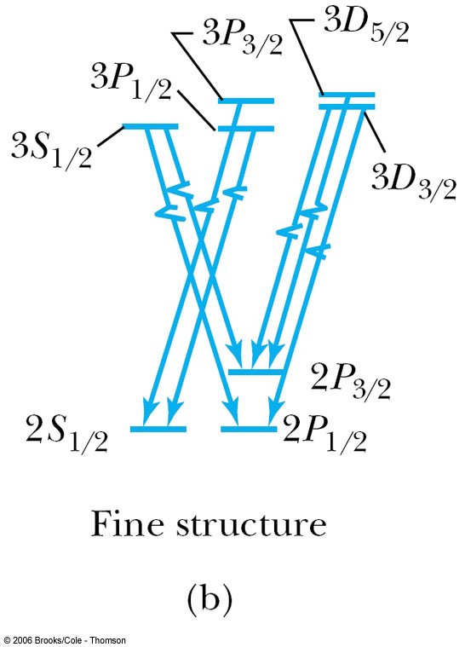
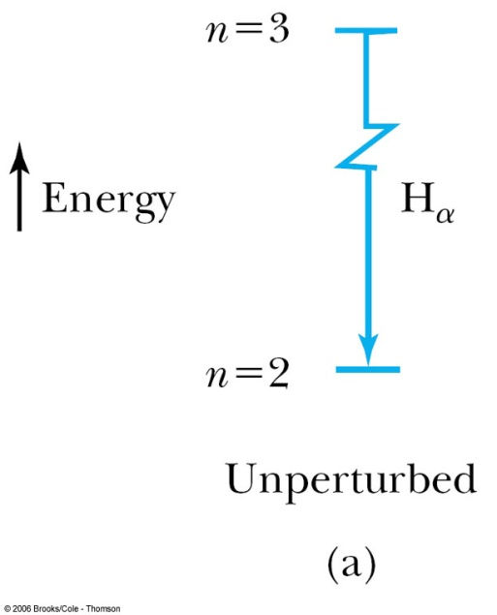
Total Angular Momentum
Now the selection rules for a single-electron atom become
  Δn = anything Δℓ = ±1
  Δmj = 0, ±1 Δj = 0, ±1
Hydrogen energy-level diagram for n = 2 and n = 3 with the spin-orbit splitting.

Slide 17

Many-Electron Atoms
Hund’s rules:
The total spin angular momentum S should be maximized to the extent possible without violating the Pauli exclusion principle.
Insofar as rule 1 is not violated, L should also be maximized.
For atoms having subshells less than half full, J should be minimized.
For labeled two-electron atom
There are LS coupling and jj coupling to combine four angular momenta J.

Slide 18
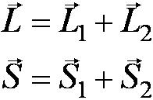
LS Coupling
This is used for most atoms when the magnetic field is weak.
If two electrons are single subshell, S = 0 or 1 depending on whether the spins are antiparallel or parallel.
For given L, there are 2S + 1 values of J.
For L > S, J goes from L − S to L + S.
For L < S, there are fewer than 2S + 1 possible J values.
The value of 2S + 1 is the multiplicity of the state.

Slide 19
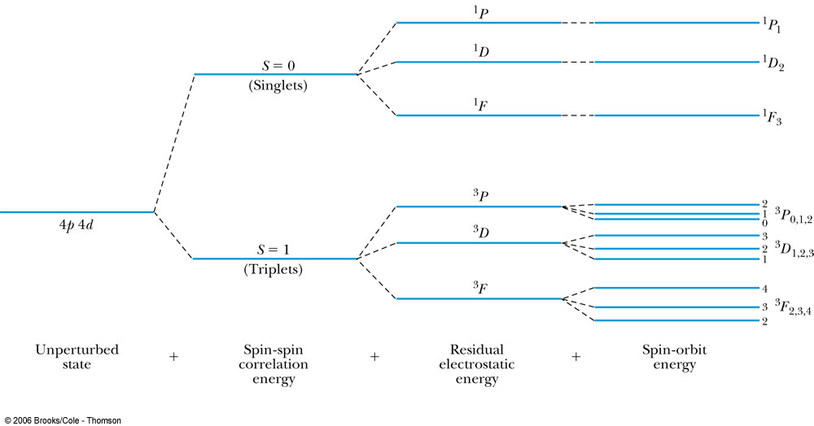
LS Coupling
The notation for a single-electron atom becomes
n^{2S+1} L_{J}
The letters and numbers are called spectroscopic symbols.
There are singlet states (S = 0) and triplet states (S = 1) for two electrons.

Slide 20
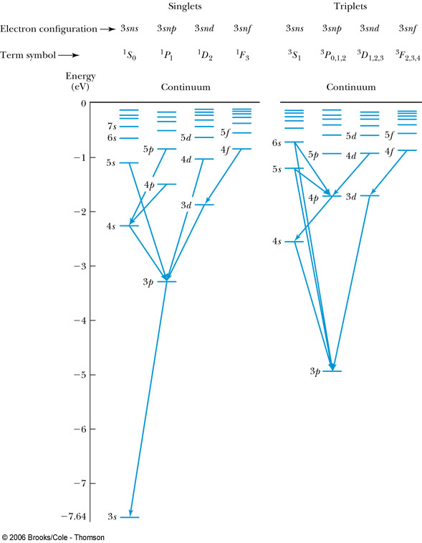
LS Coupling
There are separated energy levels according to whether they are S = 0 or 1.
Allowed transitions must have ΔS = 0.
No allowed (forbidden) transitions are possible between singlet and triplet states with much lower probability.

Slide 21
LS Coupling
The allowed transitions for the LS coupling scheme are
  ΔL = ±1 ΔS = 0
  ΔJ = 0, ±1 (J = 0 → J = 0 is forbidden)
A magnesium atom excited to the 3s3p triplet state has no lower triplet state to which it can decay.
It is called metastable, because it lives for such a long time on the atomic scale.

Slide 22


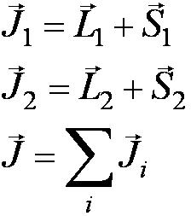
jj Coupling
It is for the heavier elements, where the nuclear charge causes the spin-orbit interactions to be as strong as the force between the individual and .

Slide 23
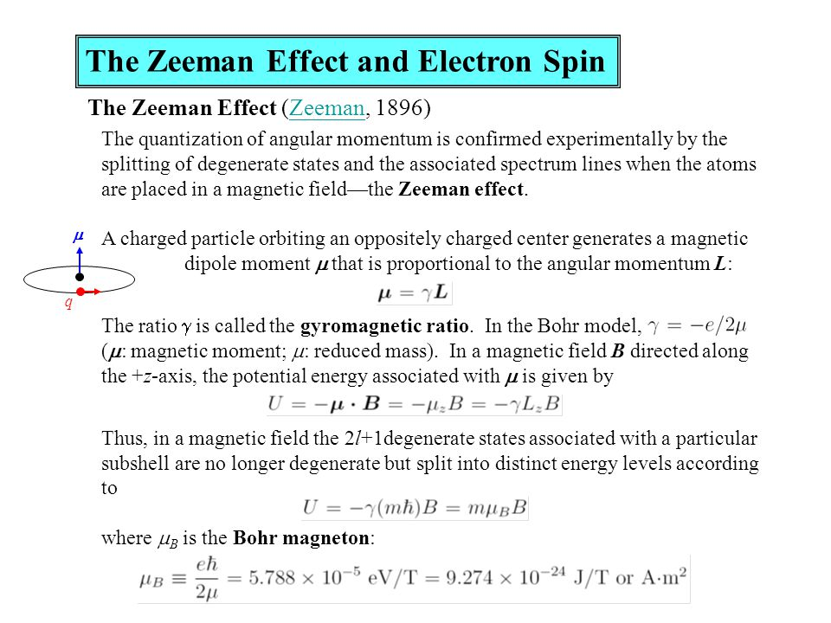

Slide 24
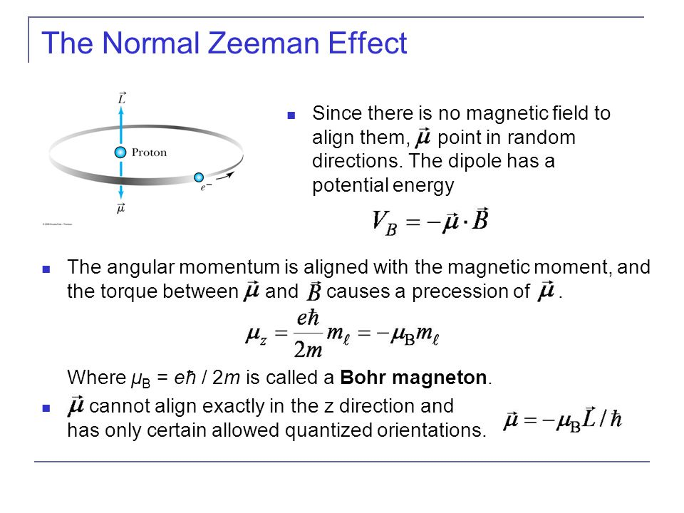

Slide 25
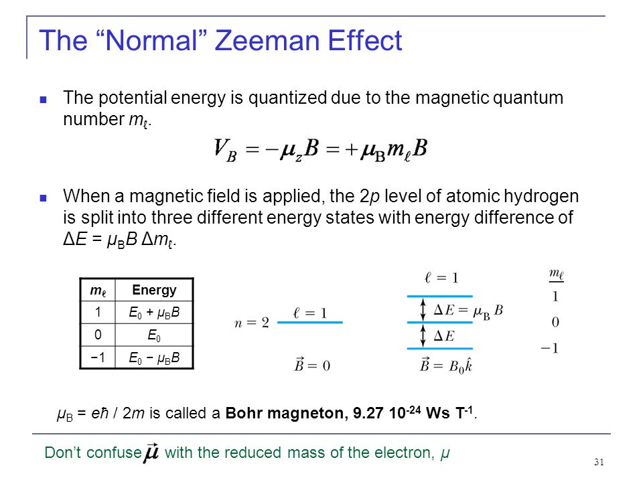

Slide 26





Anomalous Zeeman Effect
More than three closely spaced optical lines were observed.
The interaction that splits the energy levels in an external magnetic field is caused by interaction.
The magnetic moment depends on
The 2J + 1 degeneracy for a given total angular momentum state J is removed by the effect of the .
If the is small compared to internal magnetic field, then and precess about while precesses slowly about .
Orbital contribution
and
Spin magnetic moment

Slide 27
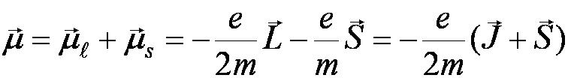
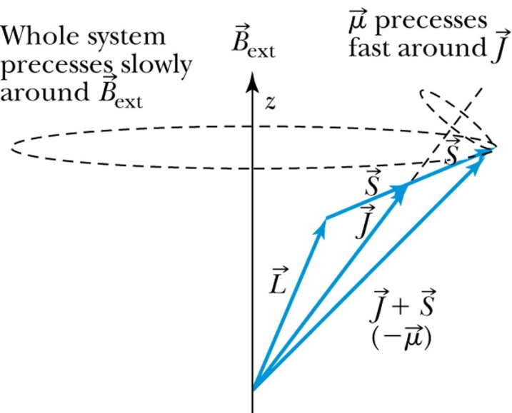
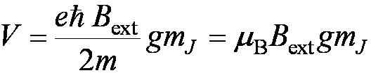
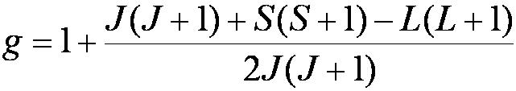

Anomalous Zeeman Effect
The total magnetic moment is
The magnetic total angular momentum numbers m_{J} from −J to J in integral steps.
splits each state J into 2J + 1 equally spaced levels separated ΔE = V.
For photon transitions between energy levels
Δm_{J} = ±1, 0 but is forbidden when ΔJ = 0.
μ_{B} is the Bohr magneton and
it is called the Landé g factor.

Slide 28
Application of Zeeman Effect:
Zeeman effect is used to produce magnetograms showing the variation of magnetic field on the sun.
A theory about the magnetic sense of Birds assumes that a protein in the retina is changed due to Zeeman effect.
In Nuclear magnetic resonance spectroscopy, Magnetic Resonance Imaging(MRI), Mossbauer spectroscopy.
Measurement of pulsed magnetic field.

